Slide 1
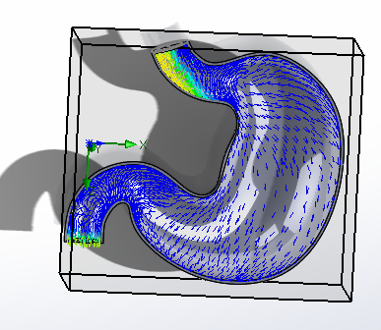
Passively Powered pH Sensor for Gastric Disorder Analysis
Nicholas Piaquadio
Project Team Members:
Tucker Lundgren
Kevin Hart
Sean Hart
Advisor: Dr. Reena Dahle

Slide 2
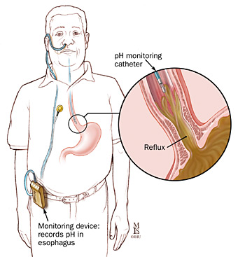
Motivation
74 percent of Americans report Gastro-Intestinal discomfort [1]
Many diseases are related to stomach pH:
Gastroesophageal reflux disease (GERD)
Stomach Ulcers/ Gastritis
Stomach Cancer

Slide 3
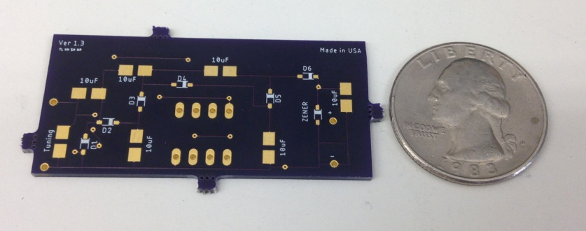
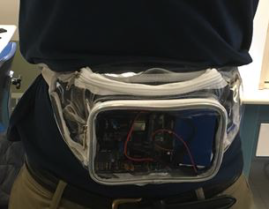
Solution
Implantable Tag
  No Battery
  Wireless Operation
Wearable Reader
  Chic Fanny Pack

Slide 4
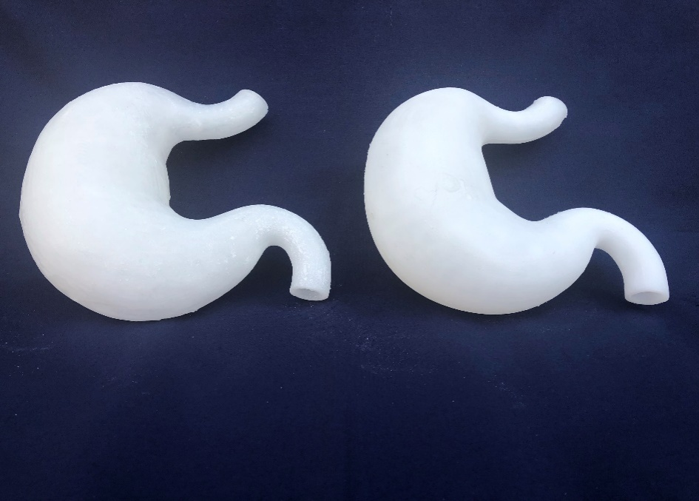
Delivered Design
Modeled Stomach
Regular pH Sensor
Applications
Animal Testing Alternative
Non-invasive in vivo testing
Real digestive motion for antacid testing

Slide 5
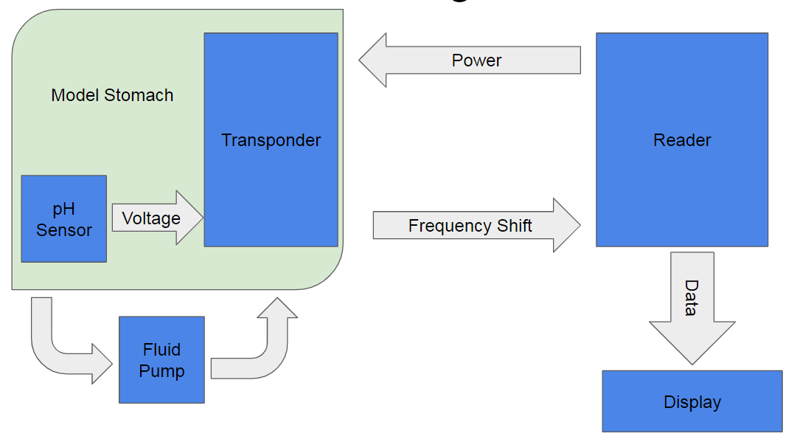
Overview

Slide 6
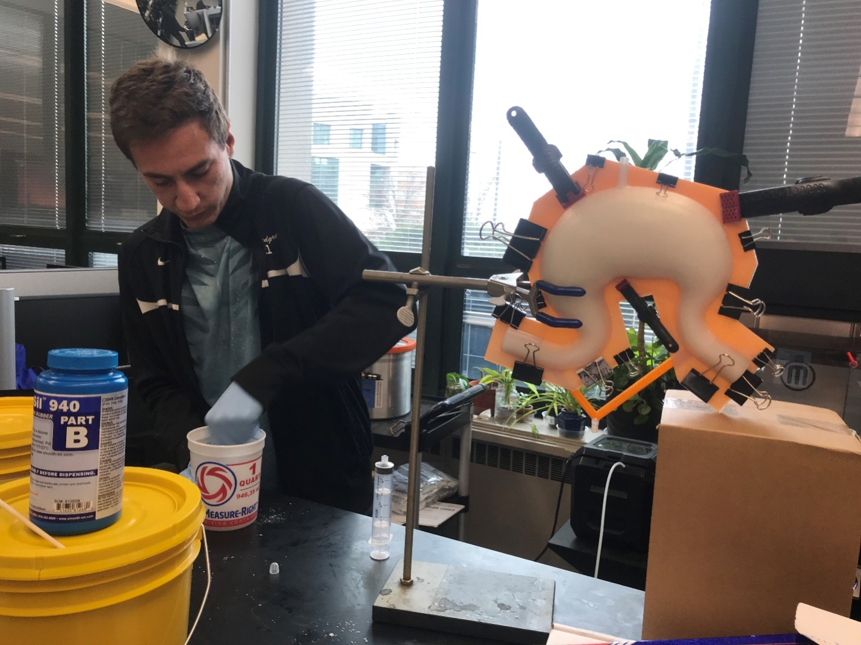
Design Constraints
IEEE-C95.1-2005 (Regulation on Human Exposure to RF EM Fields)
Small Transponder Size
Accurate pH Readings
Maximized Read Range
Budget - $600

Slide 7
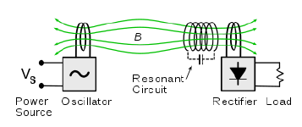

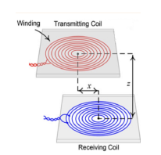

Theory: Inductive Coupling and Energy Harvesting
A changing magnetic field inside a coil induces a voltage by Faraday’s Law:
Neumann’s Formula Gives the mutual inductance:

Slide 8
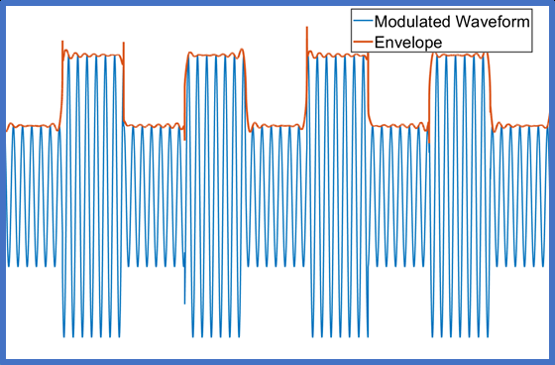
Theory: FSK Modulation
Frequency- Shift Keying
Power is in a high frequency carrier
Signal is a low frequency amplitude change

Slide 9
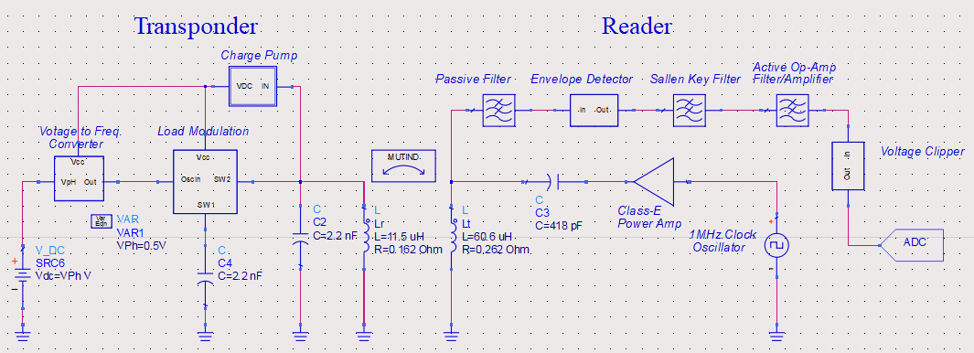
Electronics Design- Simulation
ADS Schematic: Each block is a functional circuit

Slide 10
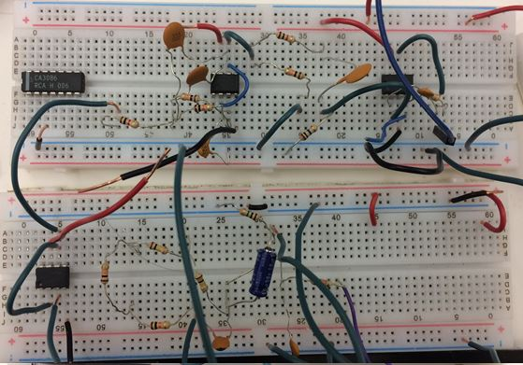
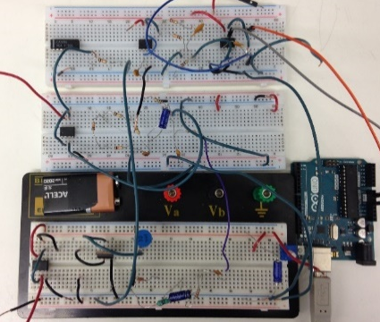
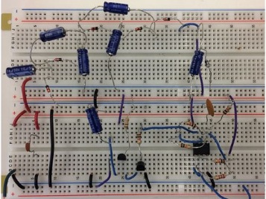
Electronics Design- Breadboarding
Reader V1
Reader V2
Implant V1

Slide 11
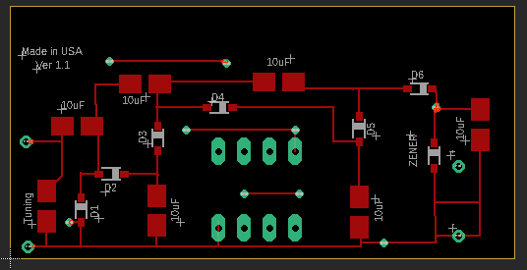
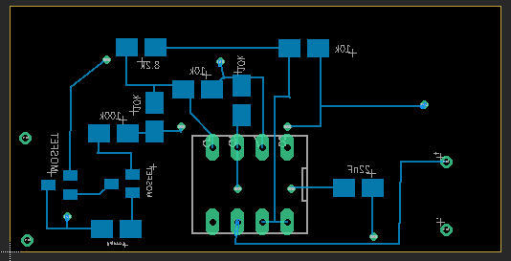
PCB Layouts - EAGLE
-Computer Aided Design: lay out circuit board
Copper Traces in blue + red
Vias in green
Double- Sided

Slide 12
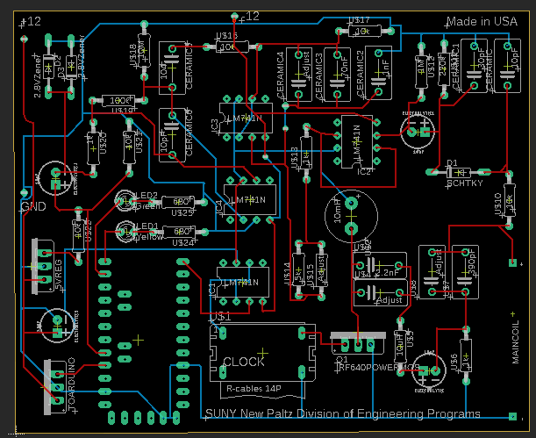
Reader Layout – Single Sided

Slide 13
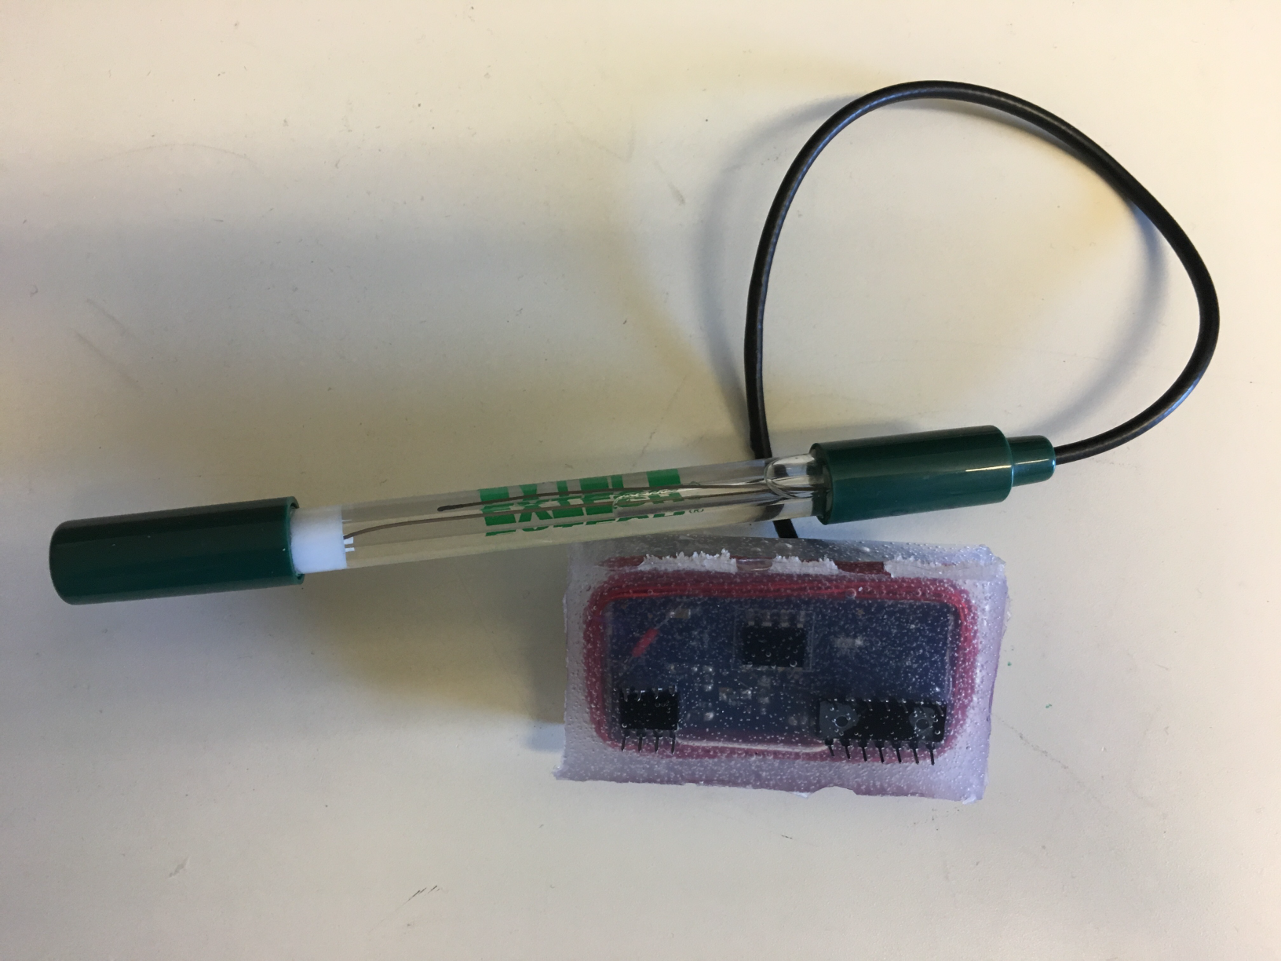
Finished Electronics - Implant
Bulky pH Probe
Coil Wrapped Around Board
Pins Simulate Microneedles
Waterproof Coating

Slide 14
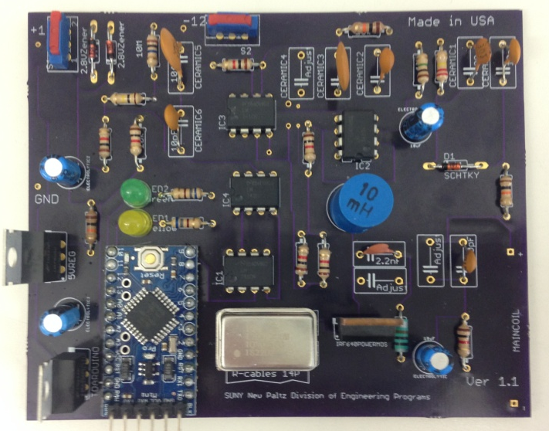
Finished Reader

Slide 15
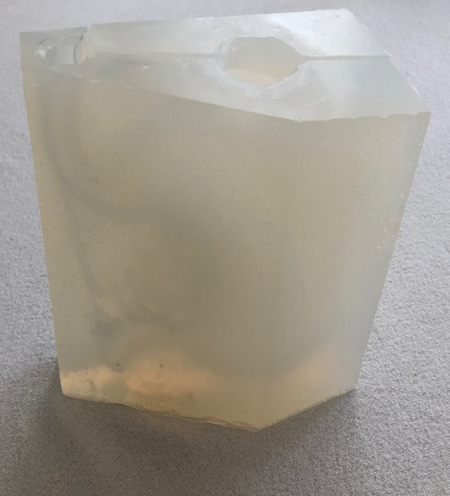
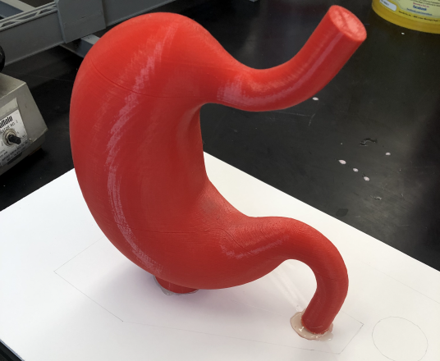
Injection Molding
3D Printed Core
Mold for Wax Core
Injection
Stomach

Slide 16
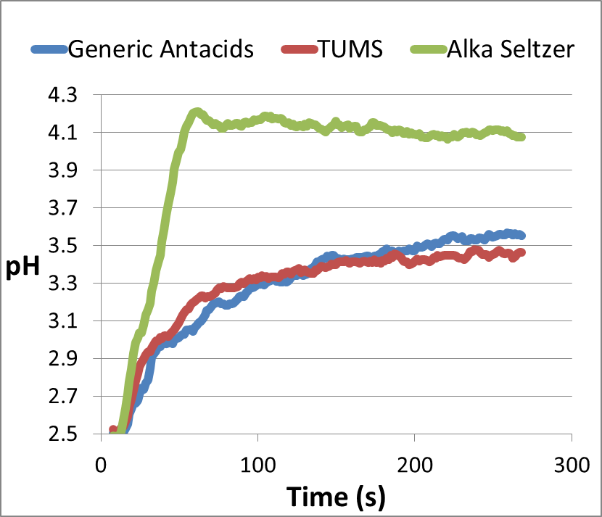
Chemical Test Results
pH Measurements of Beverages:
Antacid Testing:
Solution | A.D.A. pH [3] | System pH | % Error
pH 4 Buffer | 4.00 | 4.00 | 0.12
Pepsi Original | 2.40 | 2.46 | 2.57
Vitamin Water | 3.05 | 2.88 | -5.75
Grape Juice | 3.30 | 3.22 | -2.58
Grapefruit Juice | 3.22 | 3.30 | 2.42
Lemon Juice* | 2.25 | 2.46 | 8.69
* Not Standard Brand

Slide 17
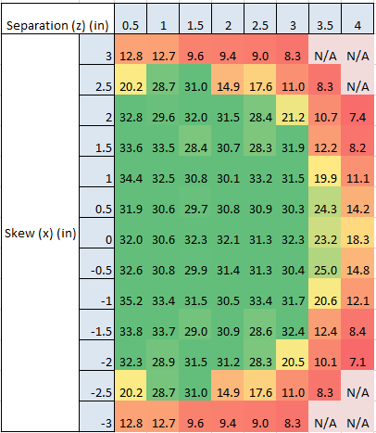
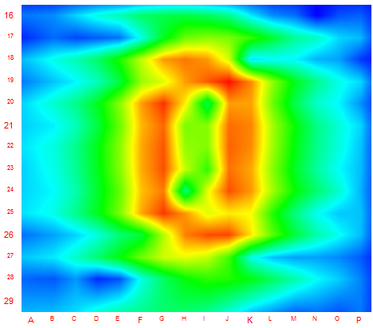
Read Range
Took Readings on XY table
Max distance of 3.5’’

Slide 18
Conclusion
Battery-less Implant + Test Setup
Iterative Design Process
System returns accurate pH out to 3.5’’
Future improvement calls for micromachining

Slide 19
References
[1]“Survey shows 74 percent of Americans living with GI discomfort,” Fox News, 24-Nov-2013. [Online]. Available: http://www.foxnews.com/health/2013/11/22/survey-shows-74-percent-americans-experience-gi-discomfort.html. [Accessed: 18-Sep-2018].
[2] “Esophageal pH monitoring,” Medigus, 2005. [Image] [Online] Available: http://www.medigus.com/healthcare-professional/clinical-presentations/119-recent-advances-in-diagnostic-testing-for-gastroesophageal-reflux-disease [Accessed:17-Sep-2018]
[3] American Dental Association . The pH of beverages in the United States. [online] Ada.org. [Accessed 16 Apr. 2019].

